Slide 1
BA Training Day 2

Slide 2

Review of Day 1
SDLC
Agile
Waterfall
Business Analysis
Business Analyst
Activities of a BA
Roles

Slide 3
Software Development Life Cycle
Is a framework defining tasks performed at each step in the software development process.
It consists of a detailed plan describing how to develop, maintain and replace specific software.
Also known as the software development process.
SDLC involves several stages.

Slide 4
Stages of SDLC
Planning: The most important parts of software development, req gathering, or requirement analysis are usually done by the most skilled and experienced software engineers in the organization. After the requirements are gathered from the client, a scope document is created in which the scope of the project is determined and documented.
2. Implementation: The software engineers start writing the code according to the client's requirements.
3. Testing: This is the process of finding defects or bugs in the created software.
4. Documentation: Every step in the project is documented for future reference and for the improvement of the software in the development process. The design documentation may include writing the application programming interface (API).
5. Deployment and maintenance: The software is deployed after it has been approved for release.
6. Maintaining: Software maintenance is done for future reference. Software improvement and new requirements (change requests) can take longer than the time needed to create the initial development of the software.

Slide 5
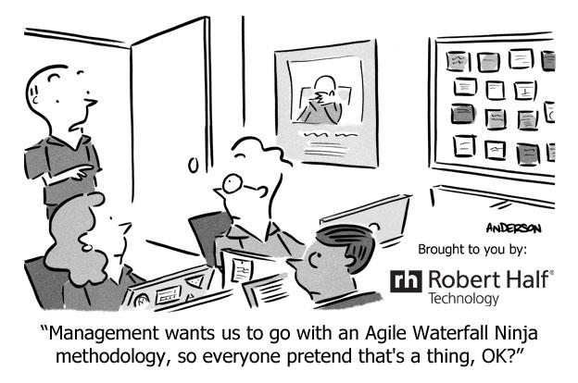
SDLC Methodologies
Agile
Waterfall
Kanban
XP
V-Model
Spiral
RUP

Slide 6
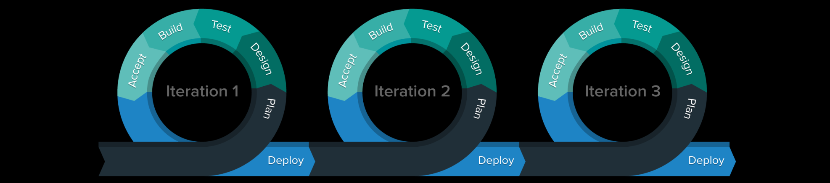
Agile
Agile project management is an iterative approach to planning and guiding project processes.
Agile development is a phrase used in software development to describe methodologies for incremental software development.
Agile development is an alternative to traditional project management where emphasis is placed on empowering people to collaborate and make team decisions in addition to continuous planning, continuous testing and continuous integration.
An iteration, in the context of an Agile project, is a timebox during which development takes place, the duration of which may vary from project to project.
Scrum is a project management framework that is applicable to any project with aggressive deadlines, complex requirements and a degree of uniqueness.

Slide 7
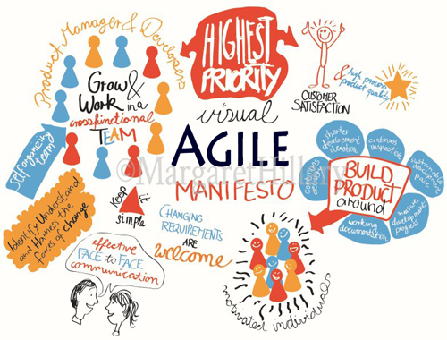
Agile Manifesto
Individuals and Interactions Over Processes and Tools
Working Software Over Comprehensive Documentation
Customer Collaboration Over Contract Negotiation
Responding to Change Over Following a Plan

Slide 8
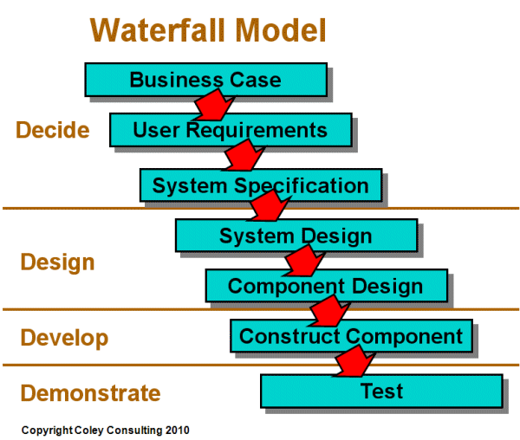
Waterfall
Waterfall approach was first SDLC Model to be used widely in Software Engineering to ensure success of the project.
Some situations where the use of Waterfall model is most appropriate are:
Requirements are very well documented, clear and fixed.
Product definition is stable.
Technology is understood and is not dynamic.
There are no ambiguous requirements.
Ample resources with required expertise are available to support the product.
The project is short.

Slide 9
Differentiate between Agile & Waterfall
Agile | Waterfall
Agile accepts change and backward scalability is possible | Under waterfall approach we cannot change the decisions and implementations that we had made under the previous stages. If we want to make changes under waterfall we will have to build the entire project from the scratch once again.
Very flexible | It is structured
Many small projects | One big project
Iterative/cyclic | A sequential process
Best for those who want continuous improvements | Suited for situations where change is uncommon
A process in which requirements are expected to evolve and change | A process that requires clearly defined requirements upfront

Slide 10
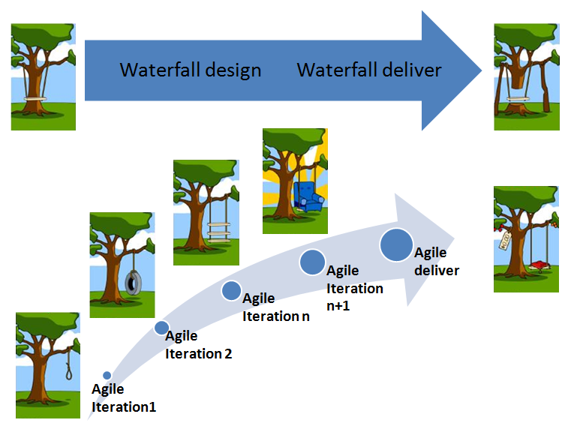
Example
Google is working on project to come up with a competing product for MS Word, that provides all the features provided by MS Word and any other features requested by the marketing team. The final product needs to be ready in 10 months of time. Let us see how this project is executed in traditional and Agile methodologies.

Slide 11
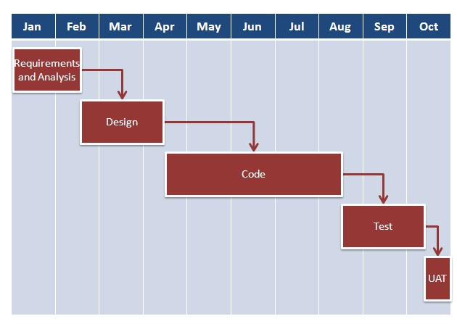
In traditional Waterfall model :–
At a high level, the project teams would spend 15% of their time on gathering requirements and analysis (1.5 months)
20% of their time on design (2 months)
40% on coding (4 months) and unit testing
20% on System and Integration testing (2 months).
At the end of this cycle, the project may also have 2 weeks of User Acceptance testing by marketing teams.
In this approach, the customer does not get to see the end product until the end of the project, when it becomes too late to make significant changes.

Slide 12
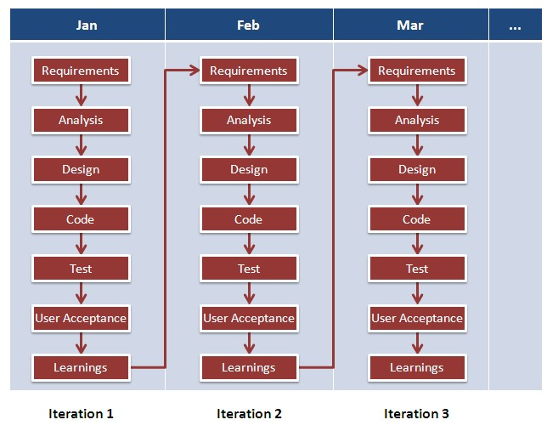
With Agile development methodology –
Each project is broken up into several ‘Iterations’.
At the end of each iteration, a working product should be delivered.
Rather than spending 1.5 months on requirements gathering, in Agile software development, the team will decide the basic core features that are required in the product and decide which of these features can be developed in the first iteration.
Any remaining features that cannot be delivered in the first iteration will be taken up in the next iteration or subsequent iterations, based on priority.
At the end of the first iterations, the team will deliver a working software with the features that were finalized for that iteration.
Say there will be 10 iterations and at the end of each iteration the customer is delivered a working software that is incrementally enhanced and updated with the features that were shortlisted for that iteration.

Slide 13

Business Analysis
Business Analysis is the task of understanding business change needs, assessing the business impact of those changes, capturing, analyzing and documenting requirements and supporting the communication and delivery of requirements with relevant stakeholders.

Slide 14
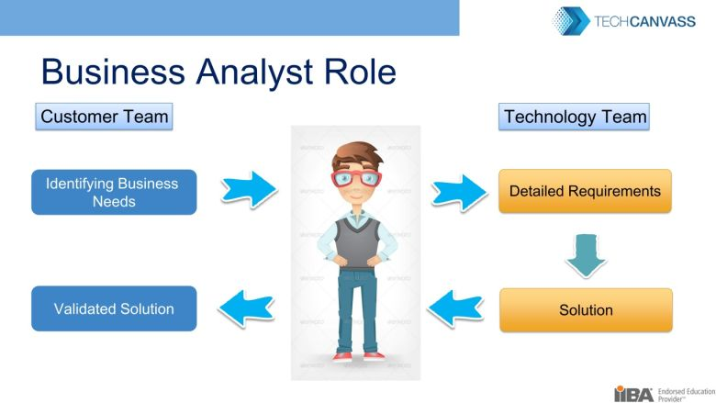
Business Analyst
A business analyst is any person who performs business analysis activities.
The business analyst is responsible for eliciting the actual needs of stakeholder which frequently involves investigating and clarifying their expressed desires in order to determine underlying issues and causes
The activities that business analysts perform include:
understanding enterprise problems and goals,
analyzing needs and solutions,
devising strategies,
driving change, and
facilitating stakeholder collaboration.

Slide 15
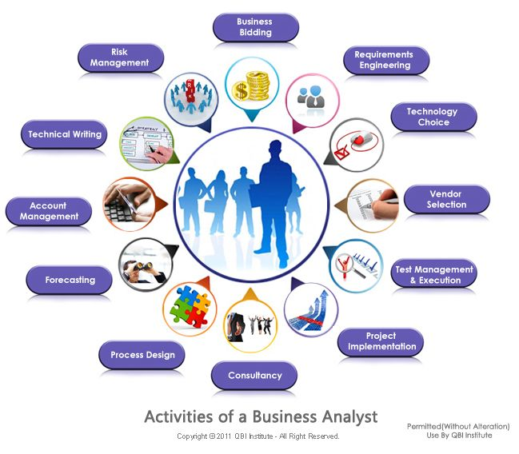
Day to Day Activities of a Business Analyst
Investigating
Analyzing
Communicating
Documenting
Evaluating

Slide 16
Roles around BA
Sponsor: A stakeholder who authorizes or legitimizes the product development effort by contracting for or paying for the project.
Stakeholder: A group or person who has interests that may be affected by an initiative or influence over it.
Customer: A stakeholder who uses products or services delivered by an organization.
Subject Matter Expert (SME): A stakeholder with specific expertise in an aspect of the problem domain or potential solution alternatives or components.
End User: A person or system that directly interacts with the solution. End users can be humans who interface with the system, or systems that send or receive data files to or from the system.
Project Manager: The stakeholder assigned by the performing organization to manage the work required to achieve the project objectives.
Tester: A stakeholder responsible for assessing the quality of, and identifying defects in, a software application.
Regulator: A stakeholder with legal or governance authority over the solution or the process used to develop it.

Slide 17


